Slide 1
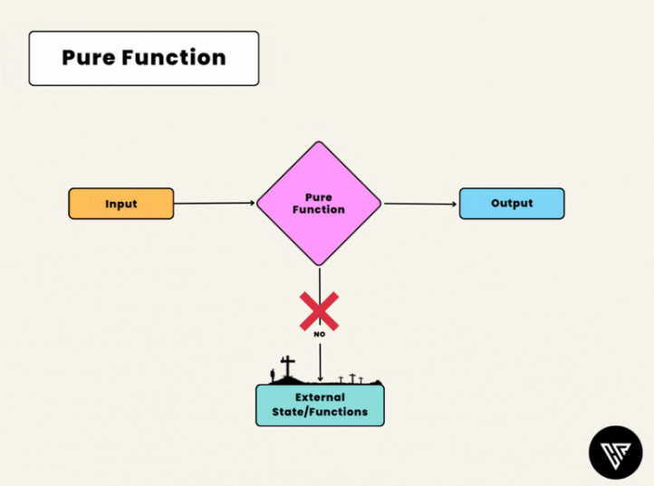
Pure function

Slide 2
1) Predictability Because pure functions always produce the same output for a given input, they are predictable and easy to reason about. Its easier to test and debug and reduces the likelihood of unexpected behavior in your code.
2) Reusability Pure functions are modular and self contained, meaning that they can be reused in different parts of your codebase without affecting other parts. This can save time and reduce the amount of code you need to write.
3) Parallelization Because pure functions do not modify external state, they can be executed in parallel without worrying about race conditions or other synchronization issues. This can lead to faster and more efficient code.

Slide 3
How to create pure functions
1) Use only input arguments Pure functions should use only their input arguments to perform calculations and return the result. They should not modify any external state or rely on external variables.
2) Avoid side effects Pure functions should not have any side effects, such as modifying external variables or objects. They should only return a value based on the input arguments.
3) Avoid global state Pure functions should avoid using global state, such as global variables or objects. This can make your code less predictable and harder to debug.
4) Return a value Pure functions should always return a value based on the input arguments. They should not rely on external variables or objects to produce their output.

